Slide 1
Economics Project – 3 Monetary and Fiscal Policies in INDIA
Group - 13

Slide 2
Group Members
Deep Parekh – 1401001
Jeet Parekh – 1401011
Akash Soni – 1401047
Kashish Shah – 1401048
Raj Shah – 1401050
Abhishek Chaudhary-1401059
Deval Shah – 1401060
Maharshi Bhavsar – 1401061
Malav Vora - 1401062

Slide 3
Outline
Resources
Theories of Monetary and Fiscal Policies
What are Monetary Policies?
Aims and Basis of Monetary Policy
What are Fiscal Policies?
Aims and Basis of Fiscal Policy
Difference between Monetary and Fiscal Policies.
Why Monetary and Fiscal policies are needed?
Monetary Policies in INDIA
Objectives of RBI for monetary policies.
Different monetary operations undertaken by RBI.
Monetary Policy Dynamics – RBI Report
Fiscal Policies in INDIA
Objectives of government for fiscal policies
Fiscal Policy Report Study 2015-2016
Union Budget 2016 – Fiscal Discipline
India’s GDP Growth
Conclusion

Slide 4
Resources
www.investopedia.com
http://www.economicsdiscussion.net/india/monetary-policy-and-fiscal-policy-of-india/10515
http://indiabudget.nic.in/ub2016-17/bh/bh1.pdf
http://www.snbmutualfunds.com/reliance-any-time-money-card-collects-rs-1500-crore/
http://indiabudget.nic.in/ub2015-16/frbm/frbm3.pdf
https://rbi.org.in/scripts/PublicationsView.aspx?id=16823#C1
http://blogs.economictimes.indiatimes.com/OfftheBeat/rbi-monetary-policy-the-best-that-mr-rajan-could-have-done/
https://rbi.org.in/Scripts/BS_ViewBulletin.aspx
http://www.levyinstitute.org/pubs/wp_820.pdf

Slide 5
Monetary Policy
Central banks have typically used monetary policy to either stimulate an economy into faster growth or slow down growth over fears of issues like inflation.
The theory is that, by incentivizing individuals and businesses to borrow and spend, monetary policy will cause the economy to grow faster than normal.
Conversely, by restricting spending and incentivizing savings, the economy will grow less quickly than normal.
The central banks controls the monetary supply in market by how much money to print because both excess money or less money in market can cause huge changes in economy of nation

Slide 6
Monetary Policy is a tool that is used by the Central Bank (in case of India, it is the Reserve Bank of India) and they do this by way of regulating the interest rates.
If the need is to stimulate the economy and to increase GDP growth, the RBI would cut interest rates. But if inflation is getting sticky and troublesome, the RBI would raise interest rates, so that the economy cools off and inflation comes down.
Here, one needs to appreciate that an increase in GDP growth rates is accompanied by inflationary growth.
To get a better conceptual understanding one would need to imagine “interest rates” to be the brakes and the “economy” the car. When the car goes too fast, brakes are applied and the car slows down and when the car slows down too much the brakes are released and the car gathers speed. So in that sense, interest rates are like the “brakes” in the hands of RBI.

Slide 7
Aims and Basis of Monetary Policy
The main purposes of the monetary policy include bringing
price stability,
controlling inflation,
strengthening the banking system,
economic growth, etc.
The monetary policy focuses on all the matters which have an influence over the composition of money, circulation of credit, interest rate structure.
There are two types of monetary policies
The policy in which the money supply is increased along with minimization of interest rates is known as Expansionary Monetary Policy.
If there is a decrease in money supply and rise in interest rates, that policy is regarded as Contractionary Monetary Policy.

Slide 8
The measures adopted by the apex bank to control credit in the economy are broadly classified into two categories:
General Measures
(Quantitative Measures):
Bank Rate
Reserve Requirements i.e. CRR, SLR etc.
Repo Rate , Reverse Repo Rate
Open market operations
Selective Measures
(Qualitative Measures):
Credit Regulation
Moral persuasion
Direct Action
Issue of directives

Slide 9
Fiscal Policy
Fiscal policy means by which government adjusts its spending levels and tax rates to monitor and influence nations economy
When the government of a country employs its tax revenue and expenditure policies to influence the overall demand and supply for commodities and services in the nation’s economy is known as Fiscal Policy.
The fiscal policy of a country is announced by the finance minister through budget every year.
Fiscal Surplus = If the govt revenue exceeds govt expenditure, then this situation is known as.
Fiscal Deficit = If the govt expenditure is greater than the govt revenue, it is known as

Slide 10
Aims and Basis Of Fiscal Policy
The main objective of the fiscal policy is to bring stability, reduce unemployment and growth of the economy.
Fiscal policies arises to fuel the nation’s economy when needed (unemployment, declined growth etc.)
The govt spends money in open money market(consumer market)demanding for goods and services.
There are several sectors that get impacted the moment the government decides to increase its spending.
The demand for the production of organizations operating in these sectors increases bringing profits and prosperity.

Slide 11
The revenues that government generates are from two markets
1)Taxes
2)Money from debt markets – Money that government lends to organization or individual in form of bond of their assets like mortgage etc.
The instruments used in the Fiscal Policy are
Level of taxation & its composition
Expenditure on various projects.
These instruments play a vital role in implementing fiscal policies.
Government every year announces fiscal policies.
If a government believes there is not enough spending and business activity in an economy, it can increase the amount of money it spends, often referred to as "stimulus" spending.
If there are not enough tax receipts to pay for the spending increases, governments borrow money by issuing debt securities and, in the process, accumulate debt, or "deficit" spending.

Slide 12
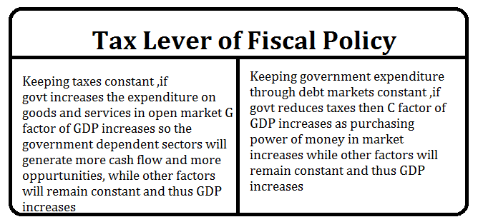
Tax Lever of Fiscal Policy
Taxes are great source of revenue stream for government.
So amount of taxes that are spend by government and also the tax charged by government to consumers has a huge impact on market economy.
Roughly we can say ,
Gross Domestic Product (GDP)=
Consumer Expenditure(C)
+ Investment(I)
+ Government Expenditure(G)
+ Net Exports(NX) .
→GDP = C + I + G +NX.

Slide 13
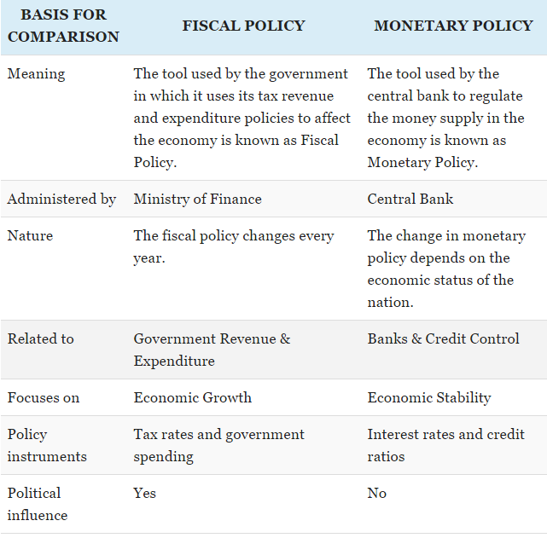
Comparison Chart

Slide 14
Why we require monetary and fiscal policies?
The economic position of a country can be monitored, controlled and regulated with the sound economic policies.
The fiscal and monetary policies of the nation are the two measures, which can help in bringing stability and developing smoothly.
Both are aimed to aggregate demand of goods and services in market to grow GDP in turn rising economy of nation ,but both the policies achieve that goal in different ways.
Monetary and fiscal policies are not much contradictory to each other , but have different means to stabilize and grow the economy

Slide 15
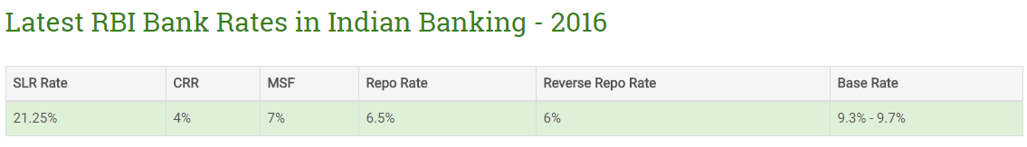
Monetary Policies In INDIA
RBI the central bank of INDIA controls the monetary policies in INDIA.
It is banker’s bank and control the banking account of all the scheduled banks.
Duty of RBI is to control credit to commercial banks through
Repo Rate/Repurchase Rate
Reverse Repo Rate
CRR – Cash Reserve Ratio
SLR – Statutory Liquidity Ratio
Call Rate
MSF – Marginal Standing Facility
Bank Rate

Slide 16
Monetary Operations taken by RBI
Repo/Bank (Repurchase) rate also known as the benchmark interest rate is the rate at which the RBI lends money to the banks for a short term.
When the repo rate increases, borrowing from RBI becomes more expensive.
If RBI wants to make it more expensive for the banks to borrow money, it increases the repo rate similarly, if it wants to make it cheaper for banks to borrow money it reduces the repo rate.
Reverse Repo rate is the short term borrowing rate at which RBI borrows money from banks.
The Reserve bank uses this tool when it feels there is too much money floating in the banking system. An increase in the reverse repo rate means that the banks will get a higher rate of interest from RBI.
As a result, banks prefer to lend their money to RBI which is always safe instead of lending it others (people, companies etc) which is always risky.
Repo Rate signifies the rate at which liquidity is injected in the banking system by RBI, whereas Reverse Repo rate signifies the rate at which the central bank absorbs liquidity from the banks. Reverse Repo Rate is linked to Repo Rate with a difference of 1% between them.

Slide 17
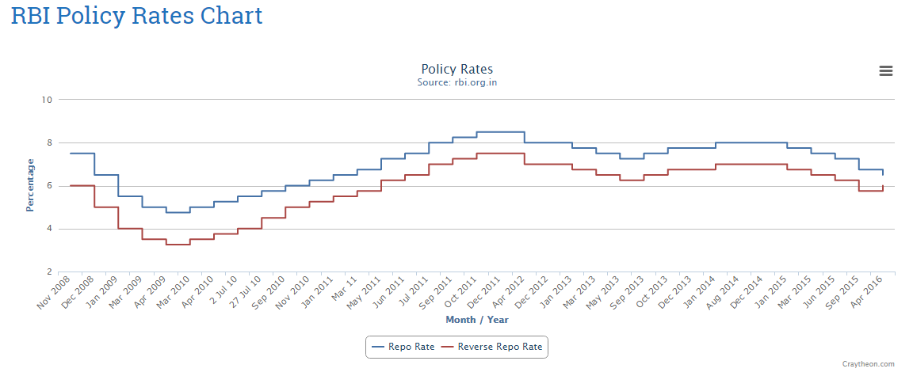
Repo rate and reverse repo rates are in sync with 1 % difference
Repo rate during march 2010 was minimum in last decade ,thus borrowing money from RBI was less expensive.
Repo rate during period Jan -Oct 2011 was huge rise because there was biggest inflation in economy in last decade ,so RBI decided to reduce money circulation in market to increase of strength of rupee.

Slide 18
CRR - Cash Reserve Ratio - Banks in India are required to hold a certain proportion of their deposits in the form of cash. However Banks don't hold these as cash with themselves, they deposit such cash(aka currency chests) with Reserve Bank of India , which is considered as equivalent to holding cash with themselves. This minimum ratio (that is the part of the total deposits to be held as cash) is stipulated by the RBI and is known as the CRR or Cash Reserve Ratio.
For instance - When a bank's deposits increase by Rs100, and if the cash reserve ratio is 9%, the banks will have to hold Rs. 9 with RBI and the bank will be able to use only Rs 91 for investments and lending, credit purpose. Therefore, higher the ratio, the lower is the amount that banks will be able to use for lending and investment.
This power of Reserve bank of India to reduce the lendable amount by increasing the CRR, makes it an instrument in the hands of a central bank through which it can control the amount that banks lend.
Thus, it is a tool used by RBI to control liquidity in the banking system and money rotation in market.
SLR - Statutory Liquidity Ratio - Every bank is required to maintain at the close of business every day, a minimum proportion of their Net Demand and Time Liabilities as liquid assets in the form of cash, gold and un-encumbered approved securities. The ratio of liquid assets to demand and time liabilities is known as Statutory Liquidity Ratio (SLR).
RBI is empowered to increase this ratio up to 40%. An increase in SLR also restricts the bank's leverage position to pump more money into the economy.
Net Demand Liabilities - Bank accounts from which you can withdraw your money at any time like your savings accounts and current account.
Time Liabilities - Bank accounts where you cannot immediately withdraw your money but have to wait for certain period. e.g. Fixed deposit accounts.

Slide 19
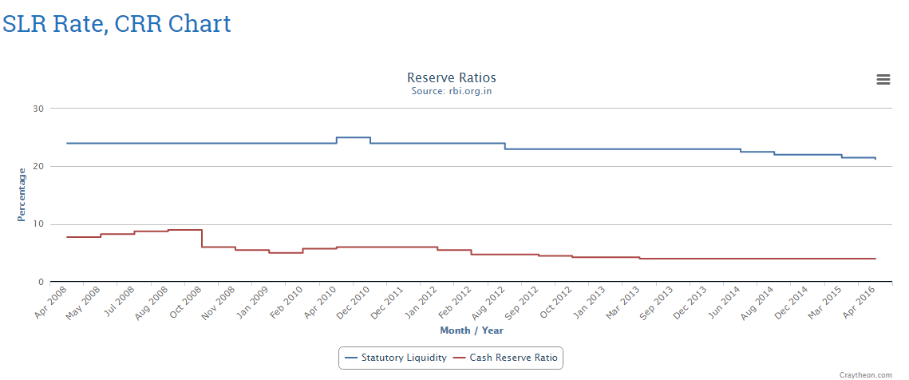
Over past decade , SLR rate has not seen huge alteration.
Also ,CRR has not been changed drastically over past decade of which last years it has remained steady to 4% till date.
This shows that credit regulation throughout country by SLR has been highly effective and CRR has reduced inflation growth thereby rising economy.

Slide 20
Call Rate - Inter bank borrowing rate - Interest Rate paid by the banks for lending and borrowing funds with maturity period ranging from one day to 14 days.
Call money market deals with extremely short term lending between banks themselves. After Lehman Brothers went bankrupt Call Rate sky rocketed to such an insane level that banks stopped lending to other banks. MSF - Marginal Standing facility - It is a special window for banks to borrow from RBI against approved government securities in an emergency situation like an acute cash shortage. MSF rate is higher then Repo rate.
Current MSF Rate is 7% Bank Rate - This is the long term rate(Repo rate is for short term) at which central bank (RBI) lends money to other banks or financial institutions. Bank rate is not used by RBI for monetary management now. It is now same as the MSF rate.
Current bank rate is 7%

Slide 21
Objectives Of Monetary Policy Of INDIA
Price Stability
Price Stability implies promoting economic development with considerable emphasis on price stability.
The center of focus is to facilitate the environment which is favorable to the architecture that enables the developmental projects to run swiftly while also maintaining reasonable price stability.
Controlled Expansion Of Bank Credit
One of the important functions of RBI is the controlled expansion of bank credit and money supply with special attention to seasonal requirement for credit without affecting the output.
Promotion of Fixed Investment
The aim here is to increase the productivity of investment by restraining non essential fixed investment.
Restriction of Inventories and stocks
Overfilling of stocks and products becoming outdated due to excess of stock often results in sickness of the unit. To avoid this problem the central monetary authority carries out this essential function of restricting the orders of the economy and all social and economic class of people
To Promote Efficiency
It tries to increase the efficiency in the financial system and tries to incorporate structural changes such as deregulating interest rates, ease operational constraints in the credit delivery system, to introduce new money market instruments etc.
Reducing the Rigidity
RBI tries to bring about the flexibilities in the operations which provide a considerable autonomy.

Slide 22
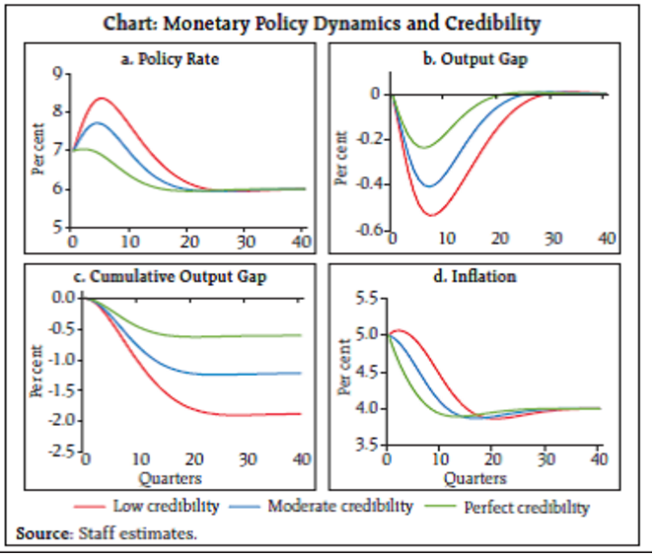
Monetary Policy Dynamics 2014 -2015 - RBI Monetary Policy Report Study
Optimal monetary policy responses have been calibrated under three alternative credibility scenarios in a model with India specific features - low credibility (0.25); moderate credibility (0.675); and perfect credibility (1.0).
Under the low credibility scenario, the central bank has to raise the policy rate aggressively to create slack in the economy for achieving disinflation (Chart).
The sacrifice ratio (the cumulative foregone annual output for each percentage point of inflation decline) is about 2.0.

Slide 23
Objective of Fiscal Policies Of Indian Govt.
The budgetary provisions made in the budgets when read together, bring out the guiding philosophy of the new fiscal policy and the objectives that the government intends to achieve.
Restoring Fiscal Equilibrium
Reforming Tax-structure
Promoting Socially Desirable Activities
Market-Oriented Development

Slide 24
i) Restoring Fiscal Equilibrium:
A very important feature of the government’s efforts is to attain a match between the revenue receipts and revenue expenditure with the ultimate aim of securing surpluses on revenue account for capital expenditure.
Towards this end, three types of measures have been taken. The first concerns expenditure.
This has been to slow-down the growth-rate in it despite increase in the absolute amounts. Second concerns tax-revenues.
The aim is to increase it, but unlike in the past when high taxes prevailed the policy now is to seek larger tax receipts through moderately low rates of taxes on a wider base.
Third the government has made efforts to raise profits of the public sector undertakings.
ii) Reforming Tax-structure:
The approach towards the tax system is to design it in such a manner that it becomes growth elastic and gets in line with the tax-systems of other fast-growing and developed countries.
To ensure better compliance and less incentive for tax-evasion, the government has lowered the tax rates both in respect of direct taxes and indirect taxes.
At the same time schemes have been introduced to widen the base of the tax.
These together with lower tax and a wider base are very likely to raise the yield of taxes. And with growth in the activities and income of the economy, the tax receipts will increase.
This will help in integrating the Indian economy with the world economy. The benefits to the country will be an increase in exports and a larger inflow of foreign direct investment. The competitive strength and efficiency of the Indian economy will also improve.

Slide 25
iii) Promoting Socially Desirable Activities
The Government in the new fiscal policy has also provided larger expenditure, tax concessions and other incentives for the expansion of socially important sectors.
These are the sectors which are normally the responsibility of the government. The development of infrastructure is one such field of key significance for the economy.
Tax concessions in the form of tax holiday have been given to encourage the private sector to set up industries in the backward regions. Similar incentives have also been given to industries producing pollution-control equipment.
Provision has also been made for the development of R&D (Research and Development) to upgrade the technological base of the economy.
iv) Market-Oriented Development
The new fiscal policy in line with the new economic policy aims at promoting allocation of resources largely in terms of the market prices. The government has already dismantled a significant part of state- intervention and enlarged the field for the private sector.
The fiscal policy has carried this process further by offering money incentives through lower tax-rates and tax-concession to the private sector.
Supply constraints in the market have also been caused by several fiscal measures.
Reduction in custom duties on the import of capital goods to modernize domestic production is one such measure to step-up the supply of goods and services.
The lowering of the rates of indirect taxes on the consumer goods including luxury items like electronics goods, cars, etc., will encourage a growth-pattern largely based on the expansion of consumer goods industries.

Slide 26
Fiscal Policy Report Study 2015-2016 -Report of Ministry Of Financial Affairs
The fiscal policy of 2015-16 has been calibrated with two fold objectives – first, to aid economy in growth revival; and second, to institutionalize the co-operative federal structure in light of emerging views on the Centre-State fiscal relations.
While, allocations in the social and welfare sectors have been protected, it is expected that the States’ will be bringing in greater share to give fillip to government spending in these sectors.
Under the Central Plan, which falls under the exclusive domain of the Centre, allocation has been increased in the Capital spending. Similarly, higher allocations have been made to core sectors of infrastructure which have the potential to give impetus to manufacturing and job creation.

Slide 27
Apart from containing growth in expenditure, the reduction in fiscal deficit is planned to be achieved in conjunction with targeted revenue augmentation both through tax and non-tax revenues.
In FY 2013-14, Tax to GDP stood at 10.0 per cent of GDP.
Tax to GDP ratio of 10.6 per cent was targeted in BE 2014-15.
However, in RE 2014-15, Tax-GDP ratio has been revised to 9.9 per cent, a growth of 9.9 per cent over the gross tax revenues in 2013-14. Despite the growth rate improving in the current financial year, easing of inflation implied lower growth in nominal terms.
Thus, tax revenues continued to be lower than the budgeted level. Accordingly, Budget 2015-16 provides for a realistic growth of 15.8 per cent over RE 2014-15, with tax-GDP ratio at 10.3 per cent.

Slide 28
Fiscal Deficit And Tax Policy For 2015-2016
The Non-Plan expenditure in budget 2015-16 provides 8.2 per cent increase over the RE 2014-15, as compared to average growth of 11.1 per cent in last five years (from 2010-11 to RE 2014-15).
Thus, despite shrinking resource base, the Budget 2015-16 provides for Plan at the RE level nominally, with marginal decrease of 0.6 per cent.
Overall, the budget size increases by 5.7 per cent in BE 2015-16 over RE 2014-15, with fiscal deficit at 3.9 per cent of GDP, lower than 4.1 per cent in FY 2014-15.
As percentage of GDP, total expenditure is estimated to be 12.6 per cent in BE 2015- 16 as against 13.3 per cent in RE 2014-15.
For FY 2015- 16 gross tax revenues are estimated to grow at 15.8 per cent over the gross-tax revenues during 2013-14 taking tax-GDP ratio at 10.3 per cent.

Slide 29
2016 Budget Fiscal Discipline Target (Source:http://indiabudget.nic.in/ub2016-17bh/bh1.pdf)
Fiscal deficit in RE 2015-16 and BE 2016-17 retained at 3.9% and 3.5%.
Revenue Deficit target from 2.8% to 2.5% in RE 2015-16
Total expenditure projected at 19.78 lakh crore
Plan expenditure pegged at 5.50 lakh crore under Plan, increase of 15.3%
Non-Plan expenditure kept at 14.28 lakh crores
Special emphasis to sectors such as agriculture, irrigation, social sector including health, women and child development, welfare of Scheduled Castes and Scheduled Tribes, minorities, infrastructure.
Mobilization of additional finances to the extent of 31,300 crore by NHAI, PFC, REC, IREDA, NABARD and Inland Water Authority by raising Bonds.
Plan / Non-Plan classification to be done away with from 2017-18.
Every new scheme sanctioned will have a sunset date and outcome review.
Rationalized and restructured more than 1500 Central Plan Schemes into about 300 Central Sector and 30 Centrally Sponsored Schemes.
Committee to review the implementation of the FRBM Act.

Slide 30
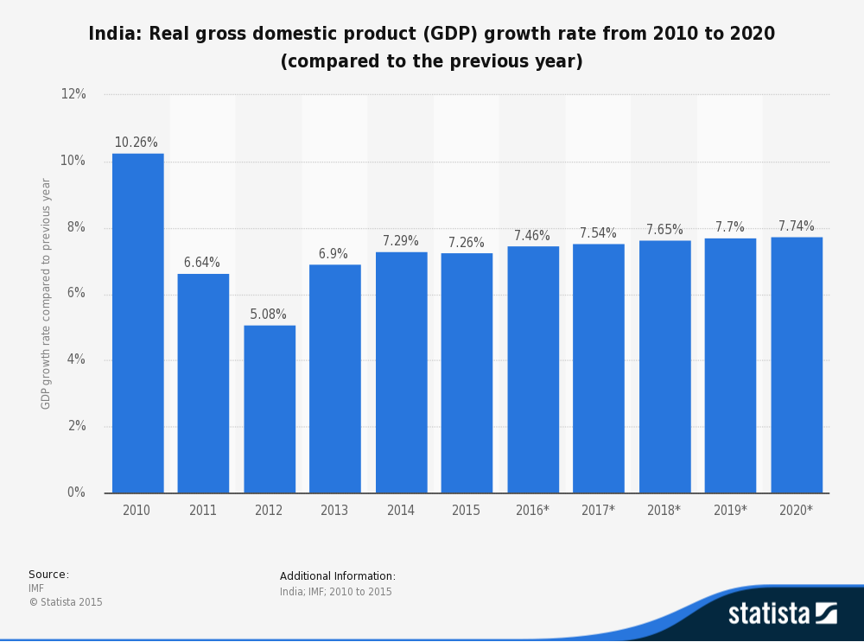
India’s GDP growth in last five year’s
The lowest GDP growth was observed during 2012 due to economic breakdown due to inflation.
Thereafter , GDP is increasing at a steady small percent and forecast of increment of 0.8% to 0.11 % is made by RBI for forthcoming years.

Slide 31
Conclusion
The main reason of confusion and bewilderment between fiscal policy and monetary policy is that the aim of both the policies are same.
The policies are formulated and implemented to bring stability and growth in the economy.
The most important difference between the two is that fiscal policy is made by the government of the respective country whereas the monetary policy is created by the central bank.
The inflation rate is steadily declining which is a good sign for Indian economy.
GDP present and forecast results are showing rising economical growth in INDIA.
Monetary and Fiscal Policies are very important for nation’s growth and every policy is taken into consideration after 360 study because it directly affects the economy of country.

Slide 32
END

